Slide 1


Printer Support Help Bot
24 x 7 Printer Support Bot Service
Powered by Azure Machine Learning

Slide 2
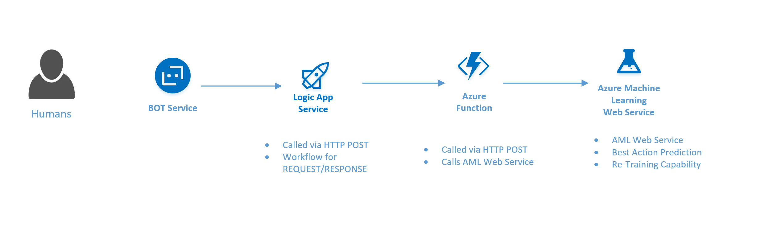
Printer Help Support Bot - Captures User Inputs via Bot Channels - Calls ML Web Service to Predict Best Solution

Slide 3
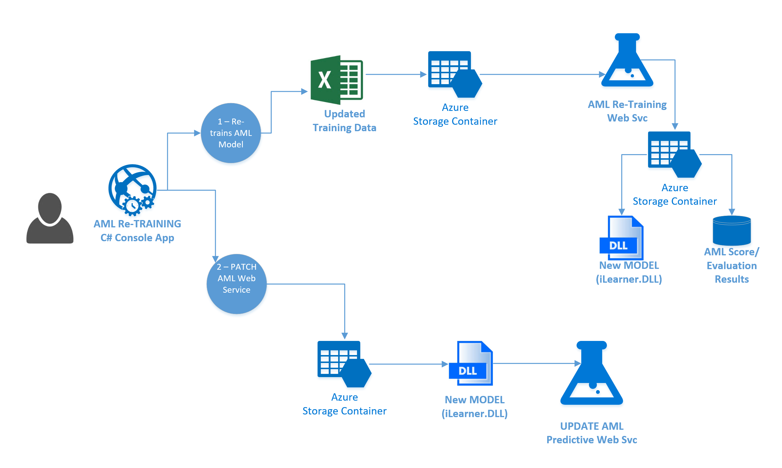
AML – Re-Training Overview:

Slide 4
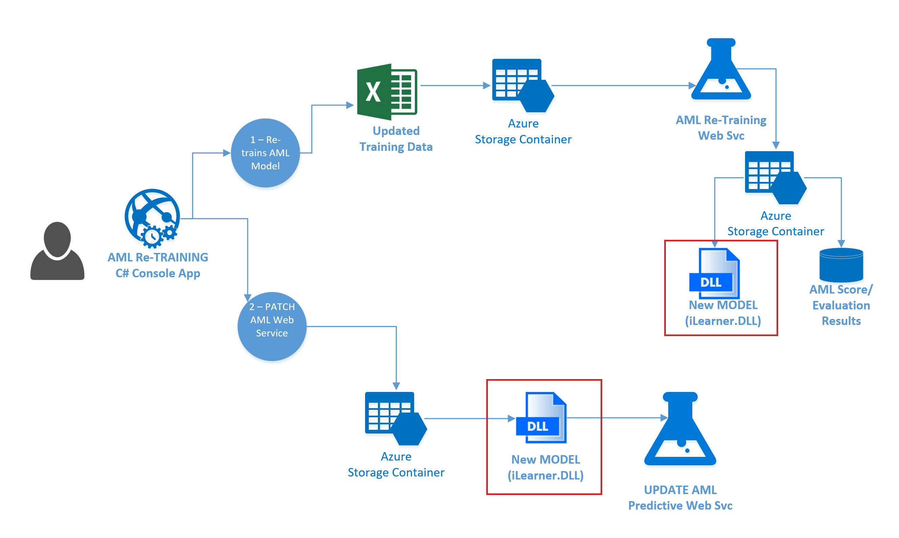
AML – Re-Training Overview:

Slide 5
AML Re-Training Steps
(1) Create TRAINING Experiment.
Upload Sample Training Data.
(2) Deploy PREDICTIVE Experiment.
TEST with console App.
(3) Modify TRAINING Experiment –> Allow RE-TRAINING.
ADD (1) Input Web Svc Endpoint.
ADD (2) OUTPUT Web Svc Endpoints.
Modify Training Data – MODIFY Solutions
ADD NEW ENDPOINT – “retrain”.
RE-TRAIN – using console app and PATCH API.
(4) Modify PREDICTIVE Experiment –> Allow RE-TRAINING.
ADD NEW ENDPOINT
RE-TRAIN – using PATCH API.
(5) PREDICT – using NEW PATCH API
Modify Console TEST App – use new “Re-trained” API.

Slide 6
AML (1) – TRAINING Experiment
Upload Sample Training Data.
Create BASE TRAINING Experiment.

Slide 7
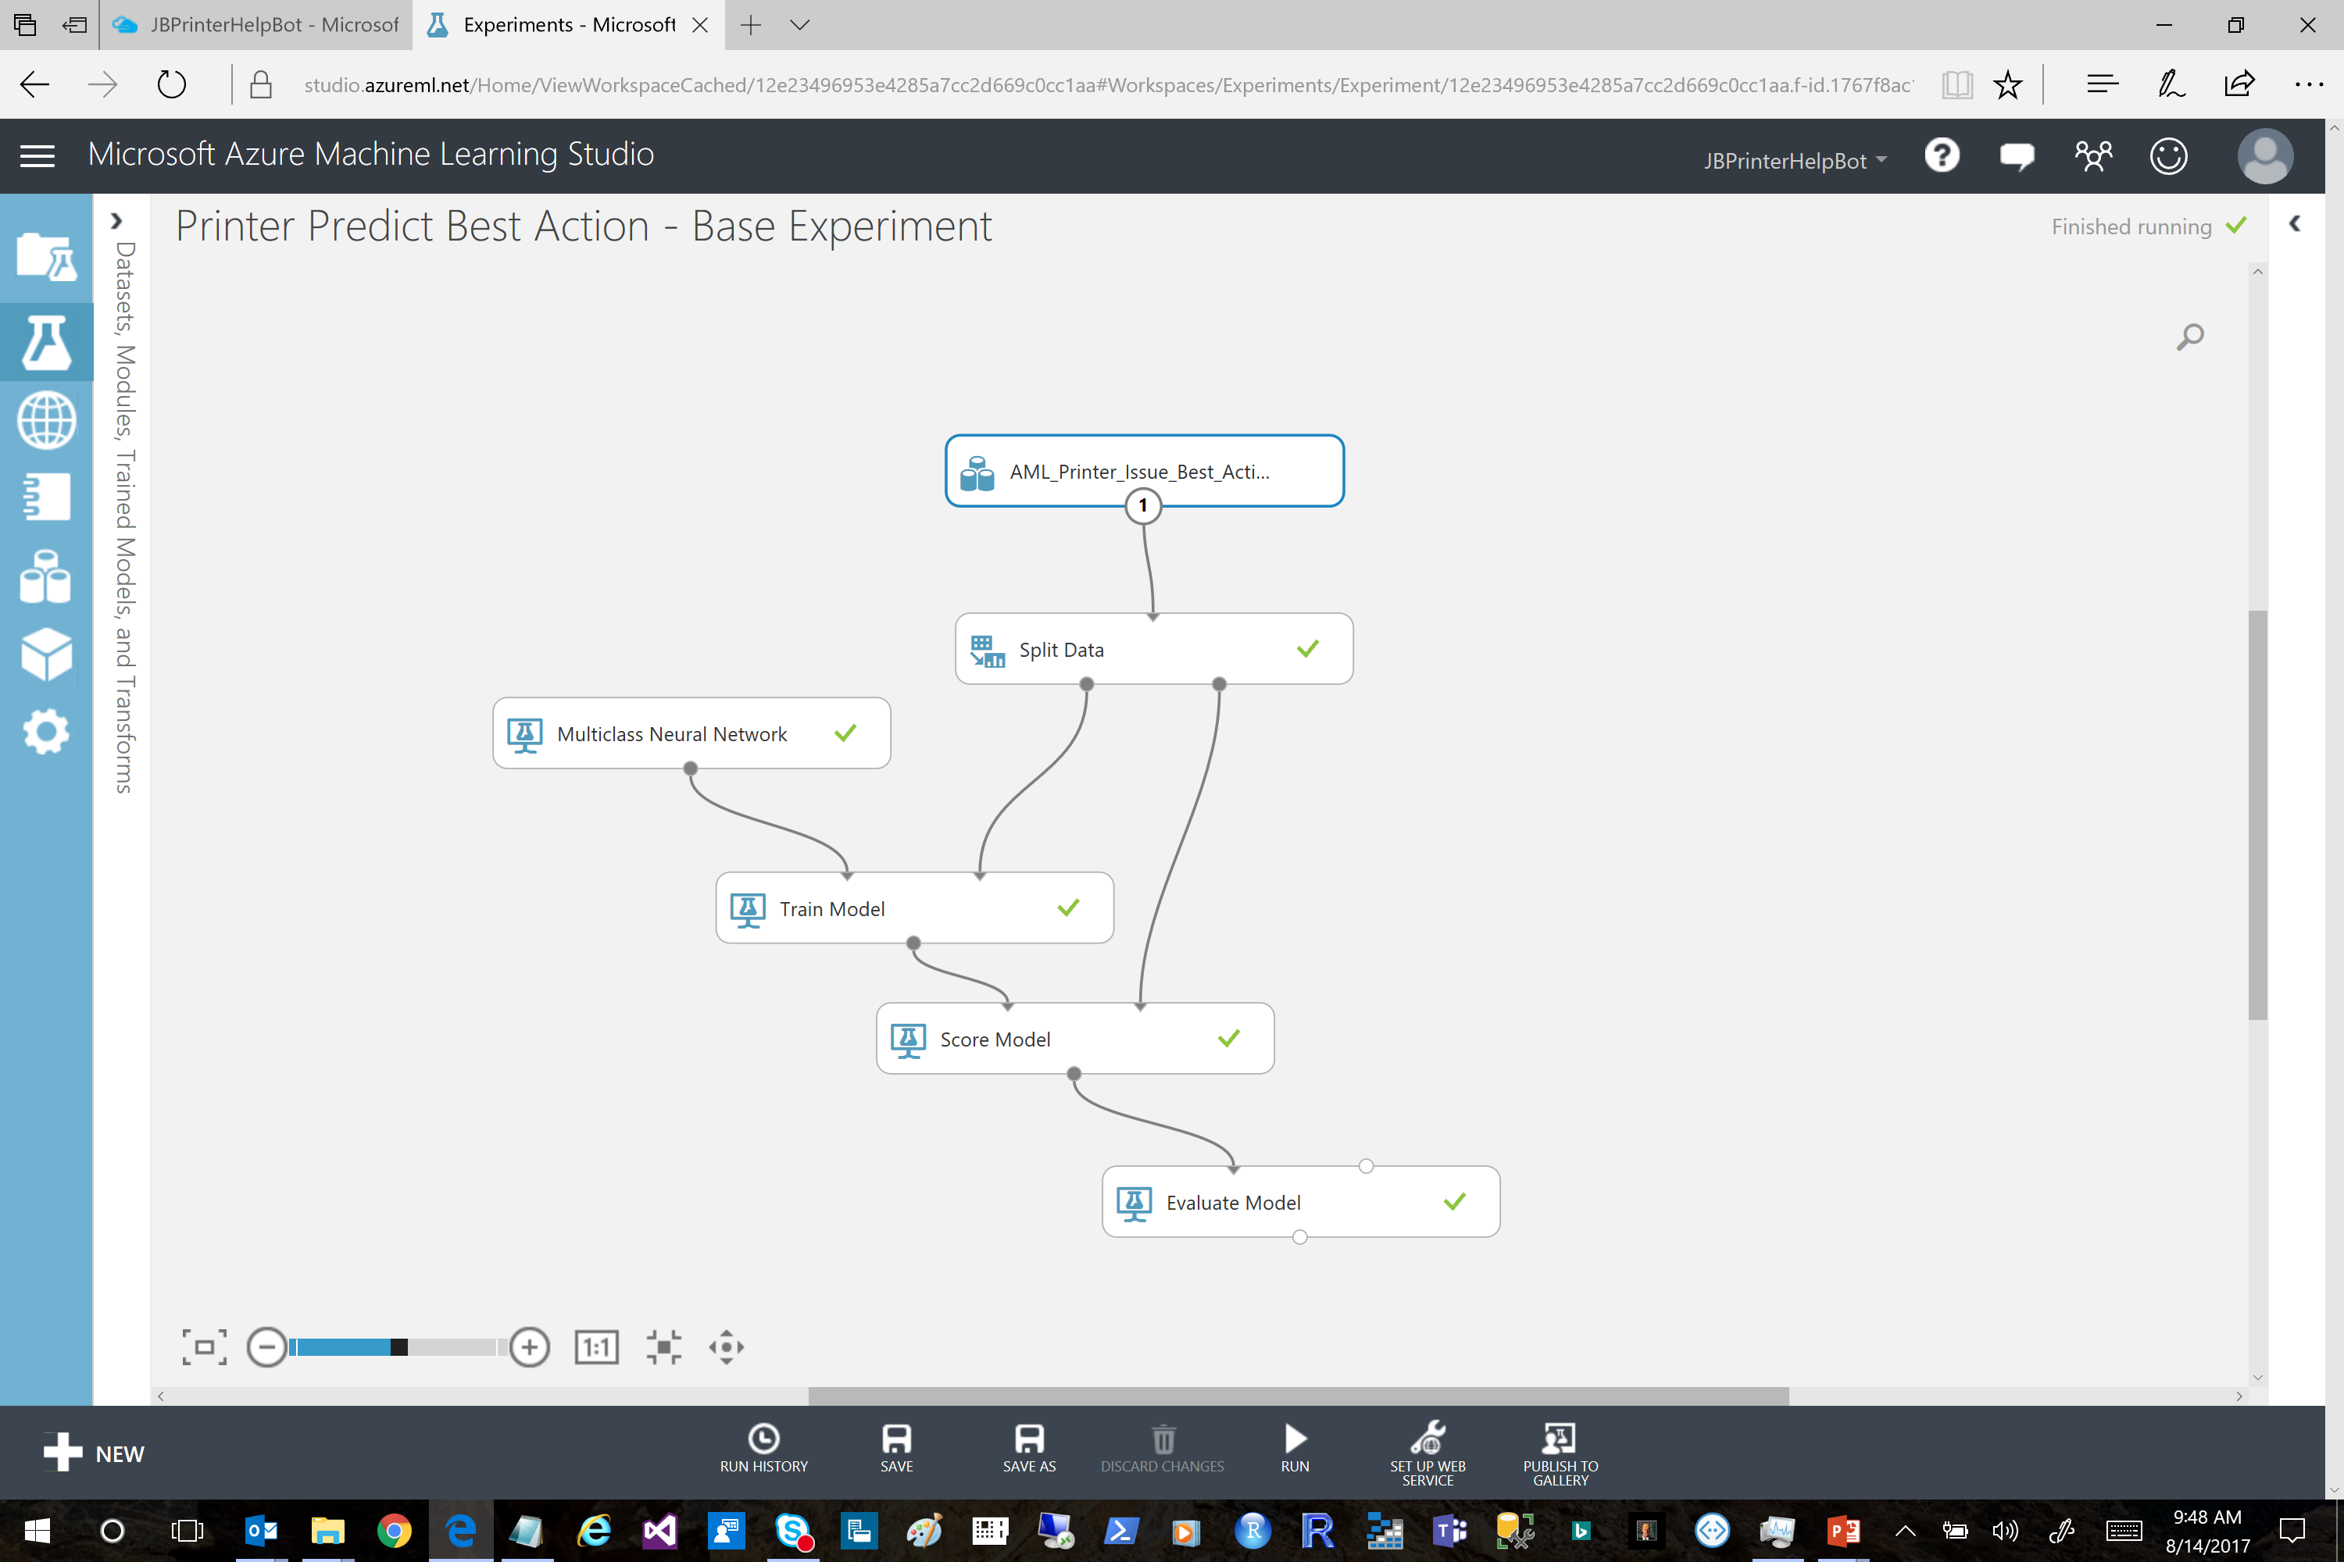

Slide 8
AML (2) – PREDICTIVE Experiment
Create Predictive Experiment FROM TRAINING Experiment.
Deploy PREDICTIVE Experiment.
TEST Web Service with Console Test App.

Slide 9
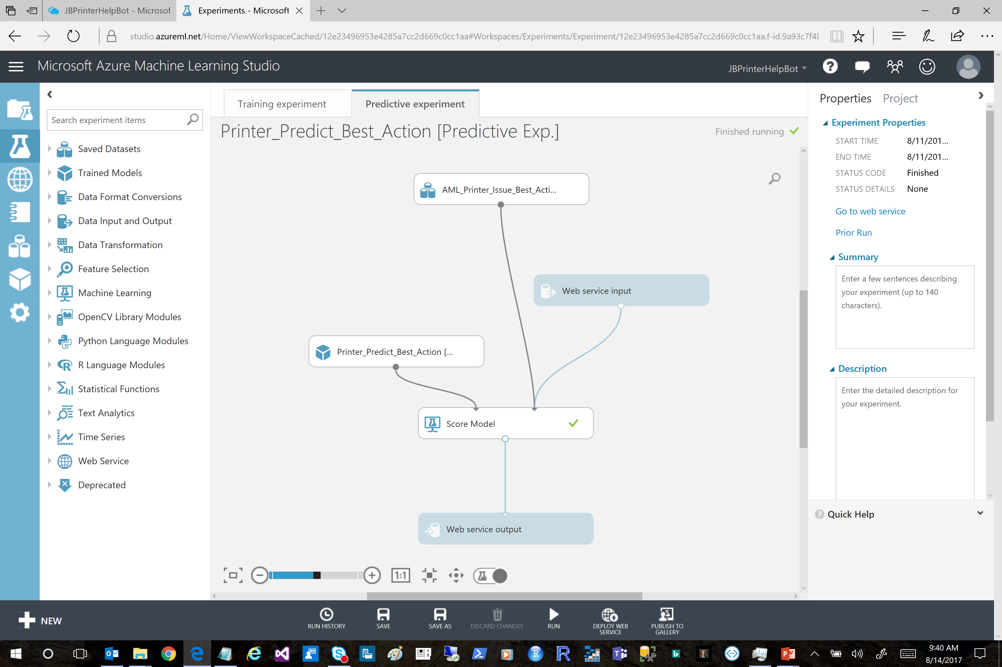

Slide 10
AML (3) – (RE)TRAINING Experiment
Modify Original TRAINING Experiment –> Allow for RE-TRAINING.
ADD (1) Input Web Svc Endpoint.
ADD (2) OUTPUT Web Svc Endpoints.
Modify Training Data
ADD NEW ENDPOINT
RE-TRAIN – using PATCH API.

Slide 11
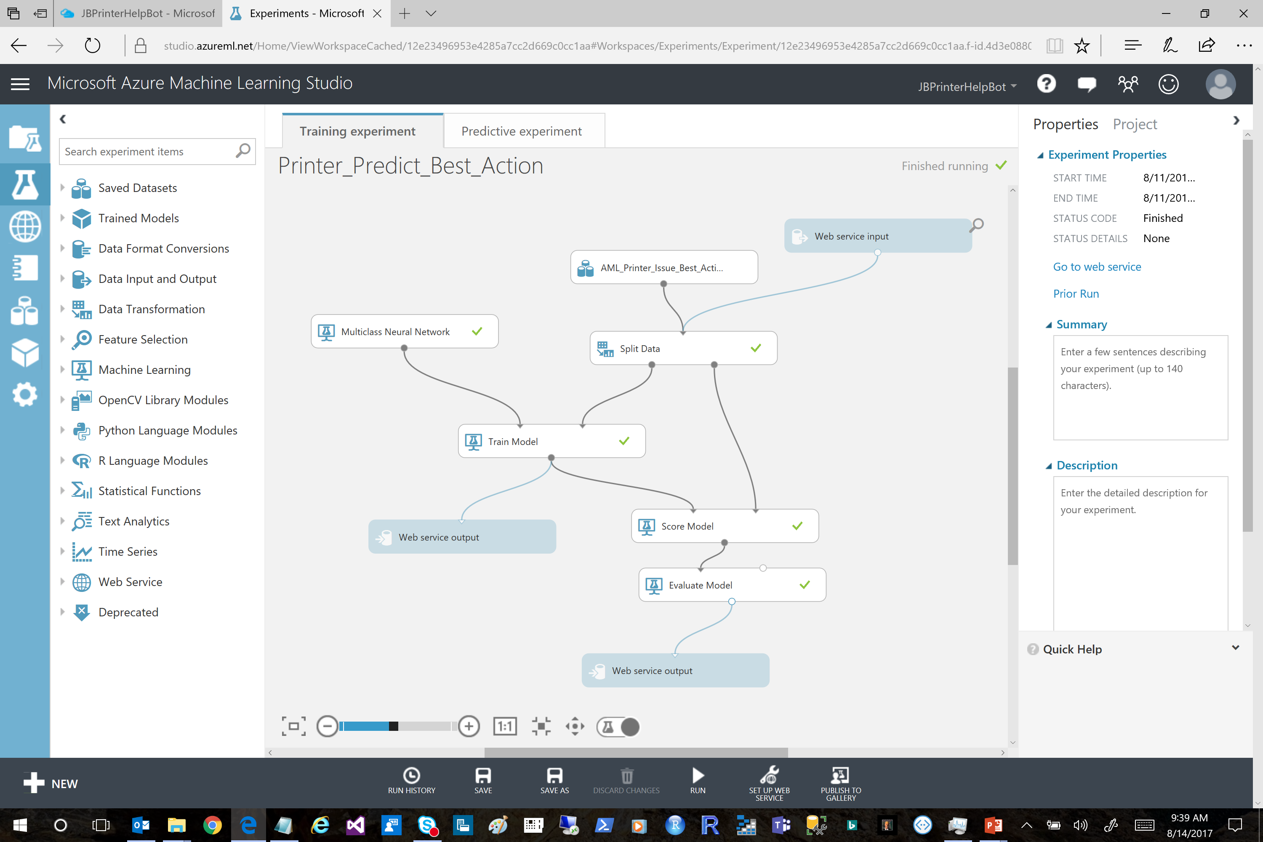

Slide 12
AML (4) – NEW PREDICTIVE Web Service URL
ORIGINAL API:
Kj1/d3T8bZSuu/XBjSW2aY8JGxelLmJTYuWIdsIue5jO2tQVhqMI0yd0qvePBs30hn73d41zoc8Ecy1aIWIPbQ==
client.BaseAddress = Uri("https://ussouthcentral.services.azureml.net/workspaces/12e23496953e4285a7cc2d669c0cc1aa/services/8871181d5f8d4940ad8fc1e9dbeeac9e/execute?api-version=2.0&details=true");
UPDATE Model:
ABr2vQonVvhmxC9Em0CmVLhyP8BCNijwXZTcEE+kqZckNC6nMXuz8Vu04eOoVoYfgHA9UKZK8Cp0hRTKY68b5w==
endpointUrl = "https://management.azureml.net/workspaces/12e23496953e4285a7cc2d669c0cc1aa/webservices/c15dace9f8594ac5a0a76d327836ec12/endpoints/retrained";
NEW (PATCHED) Web Service API:
ABr2vQonVvhmxC9Em0CmVLhyP8BCNijwXZTcEE+kqZckNC6nMXuz8Vu04eOoVoYfgHA9UKZK8Cp0hRTKY68b5w==
client.BaseAddress = Uri("https://ussouthcentral.services.azureml.net/workspaces/12e23496953e4285a7cc2d669c0cc1aa/services/18b11549110f4b5db79b9abb42375a60/execute?api-version=2.0&details=true");

Slide 13
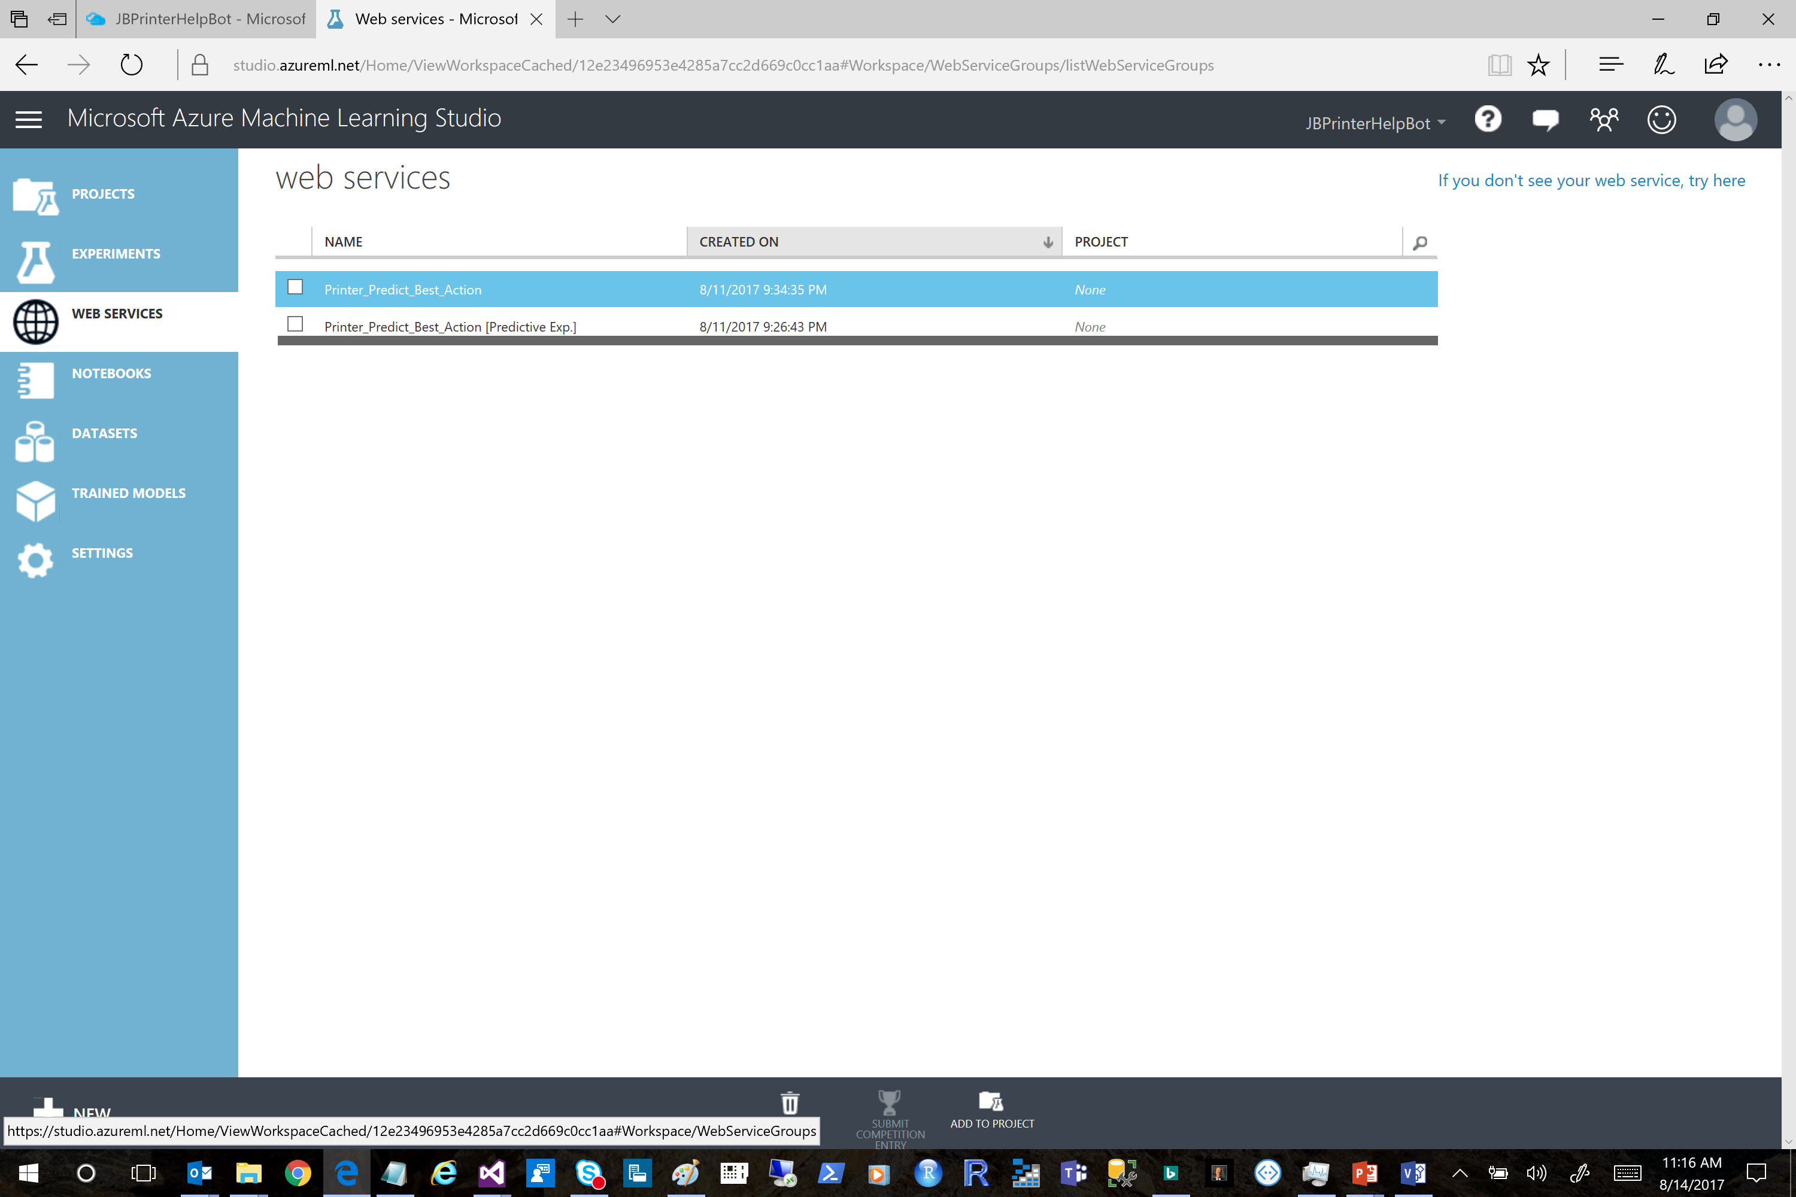

Slide 14
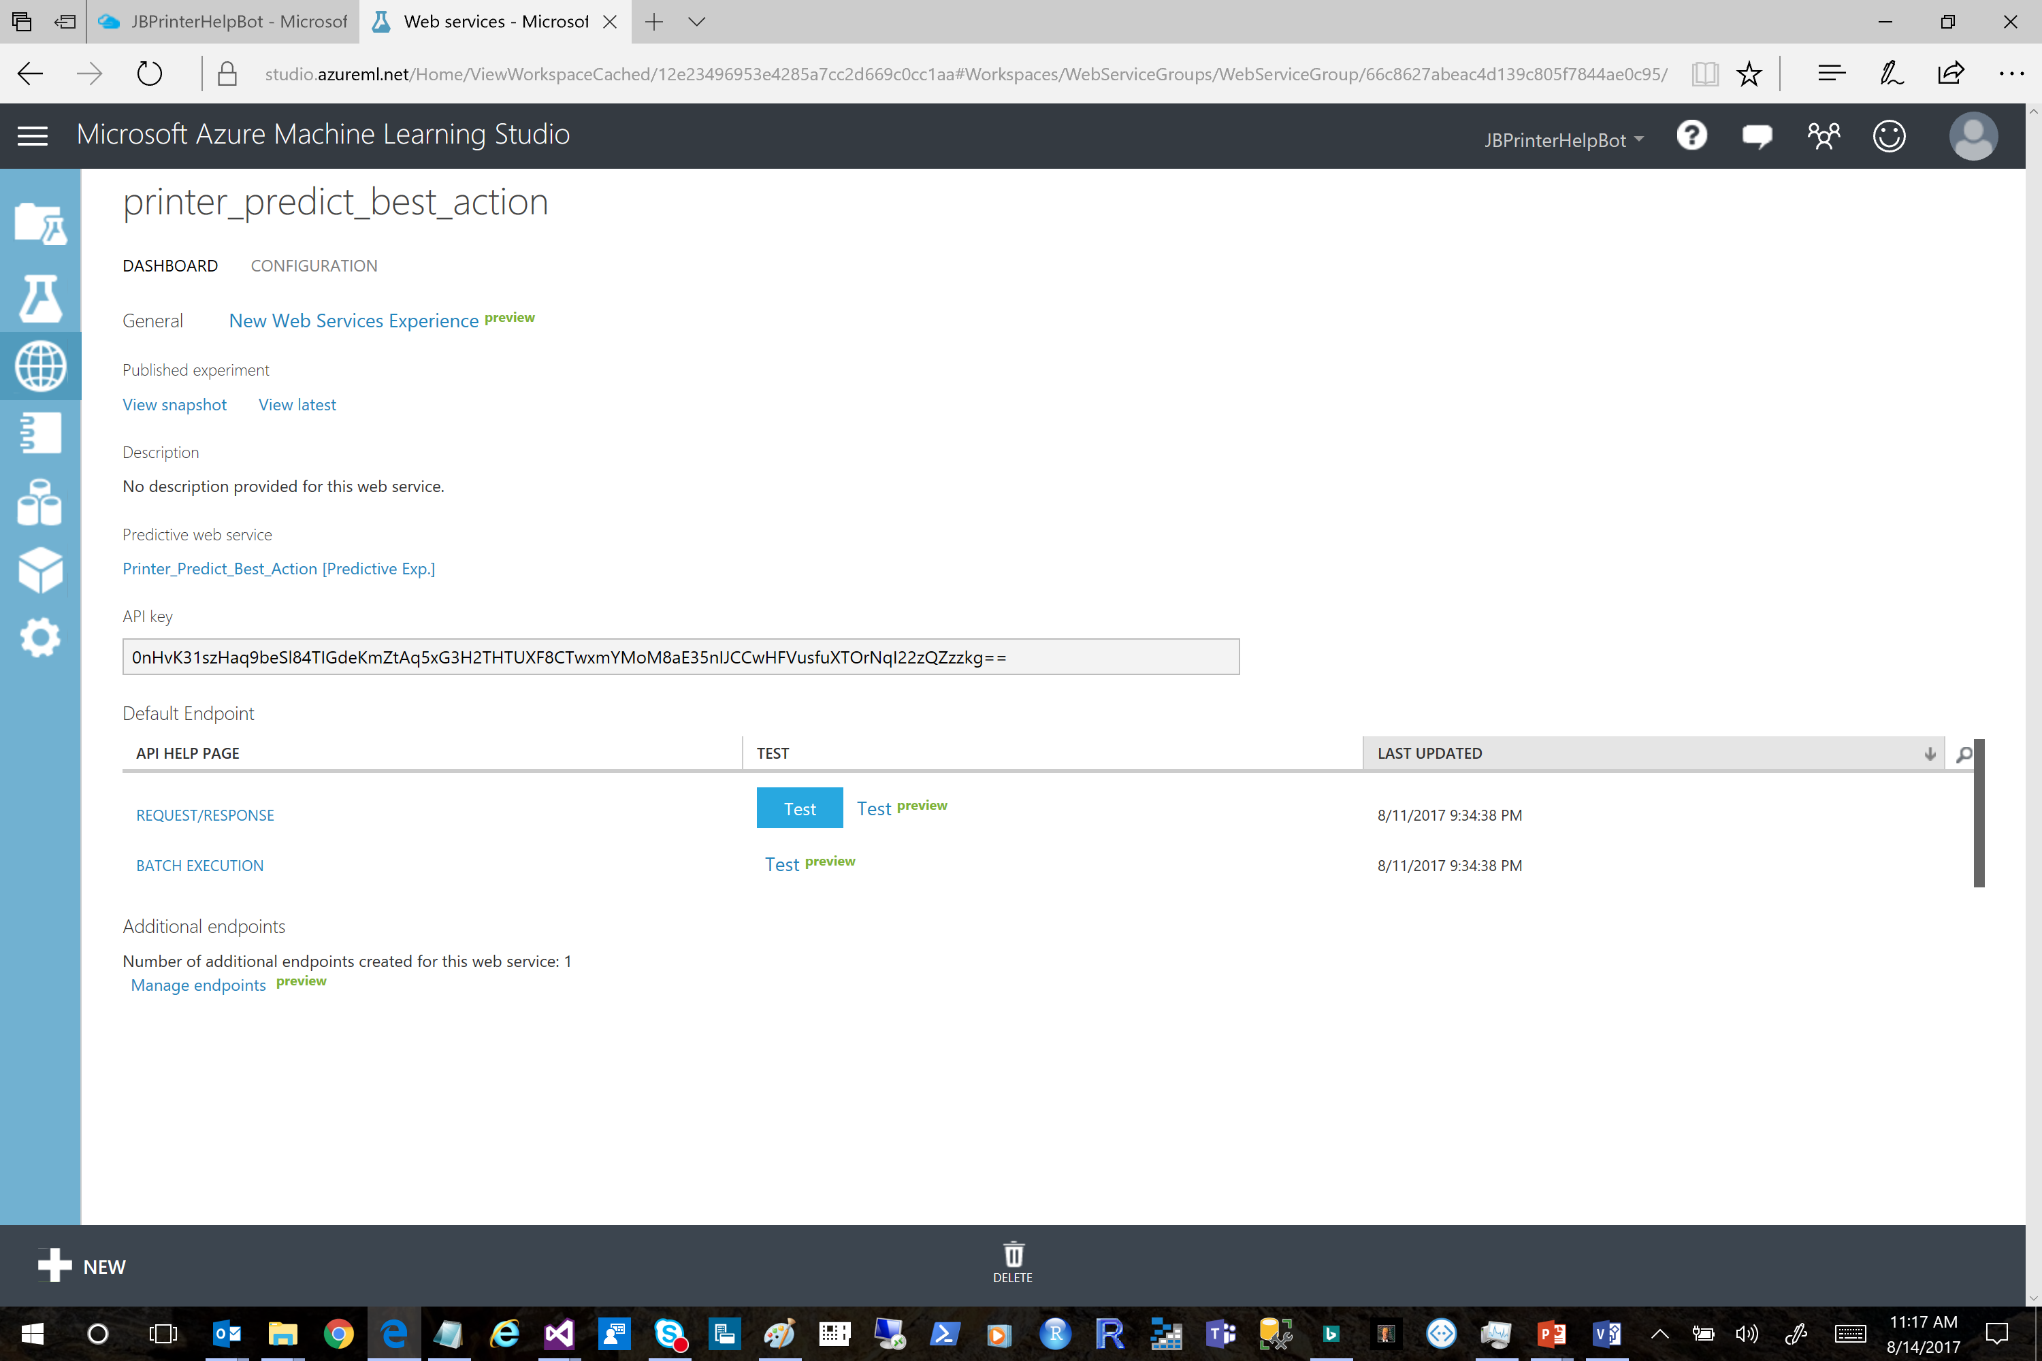

Slide 15
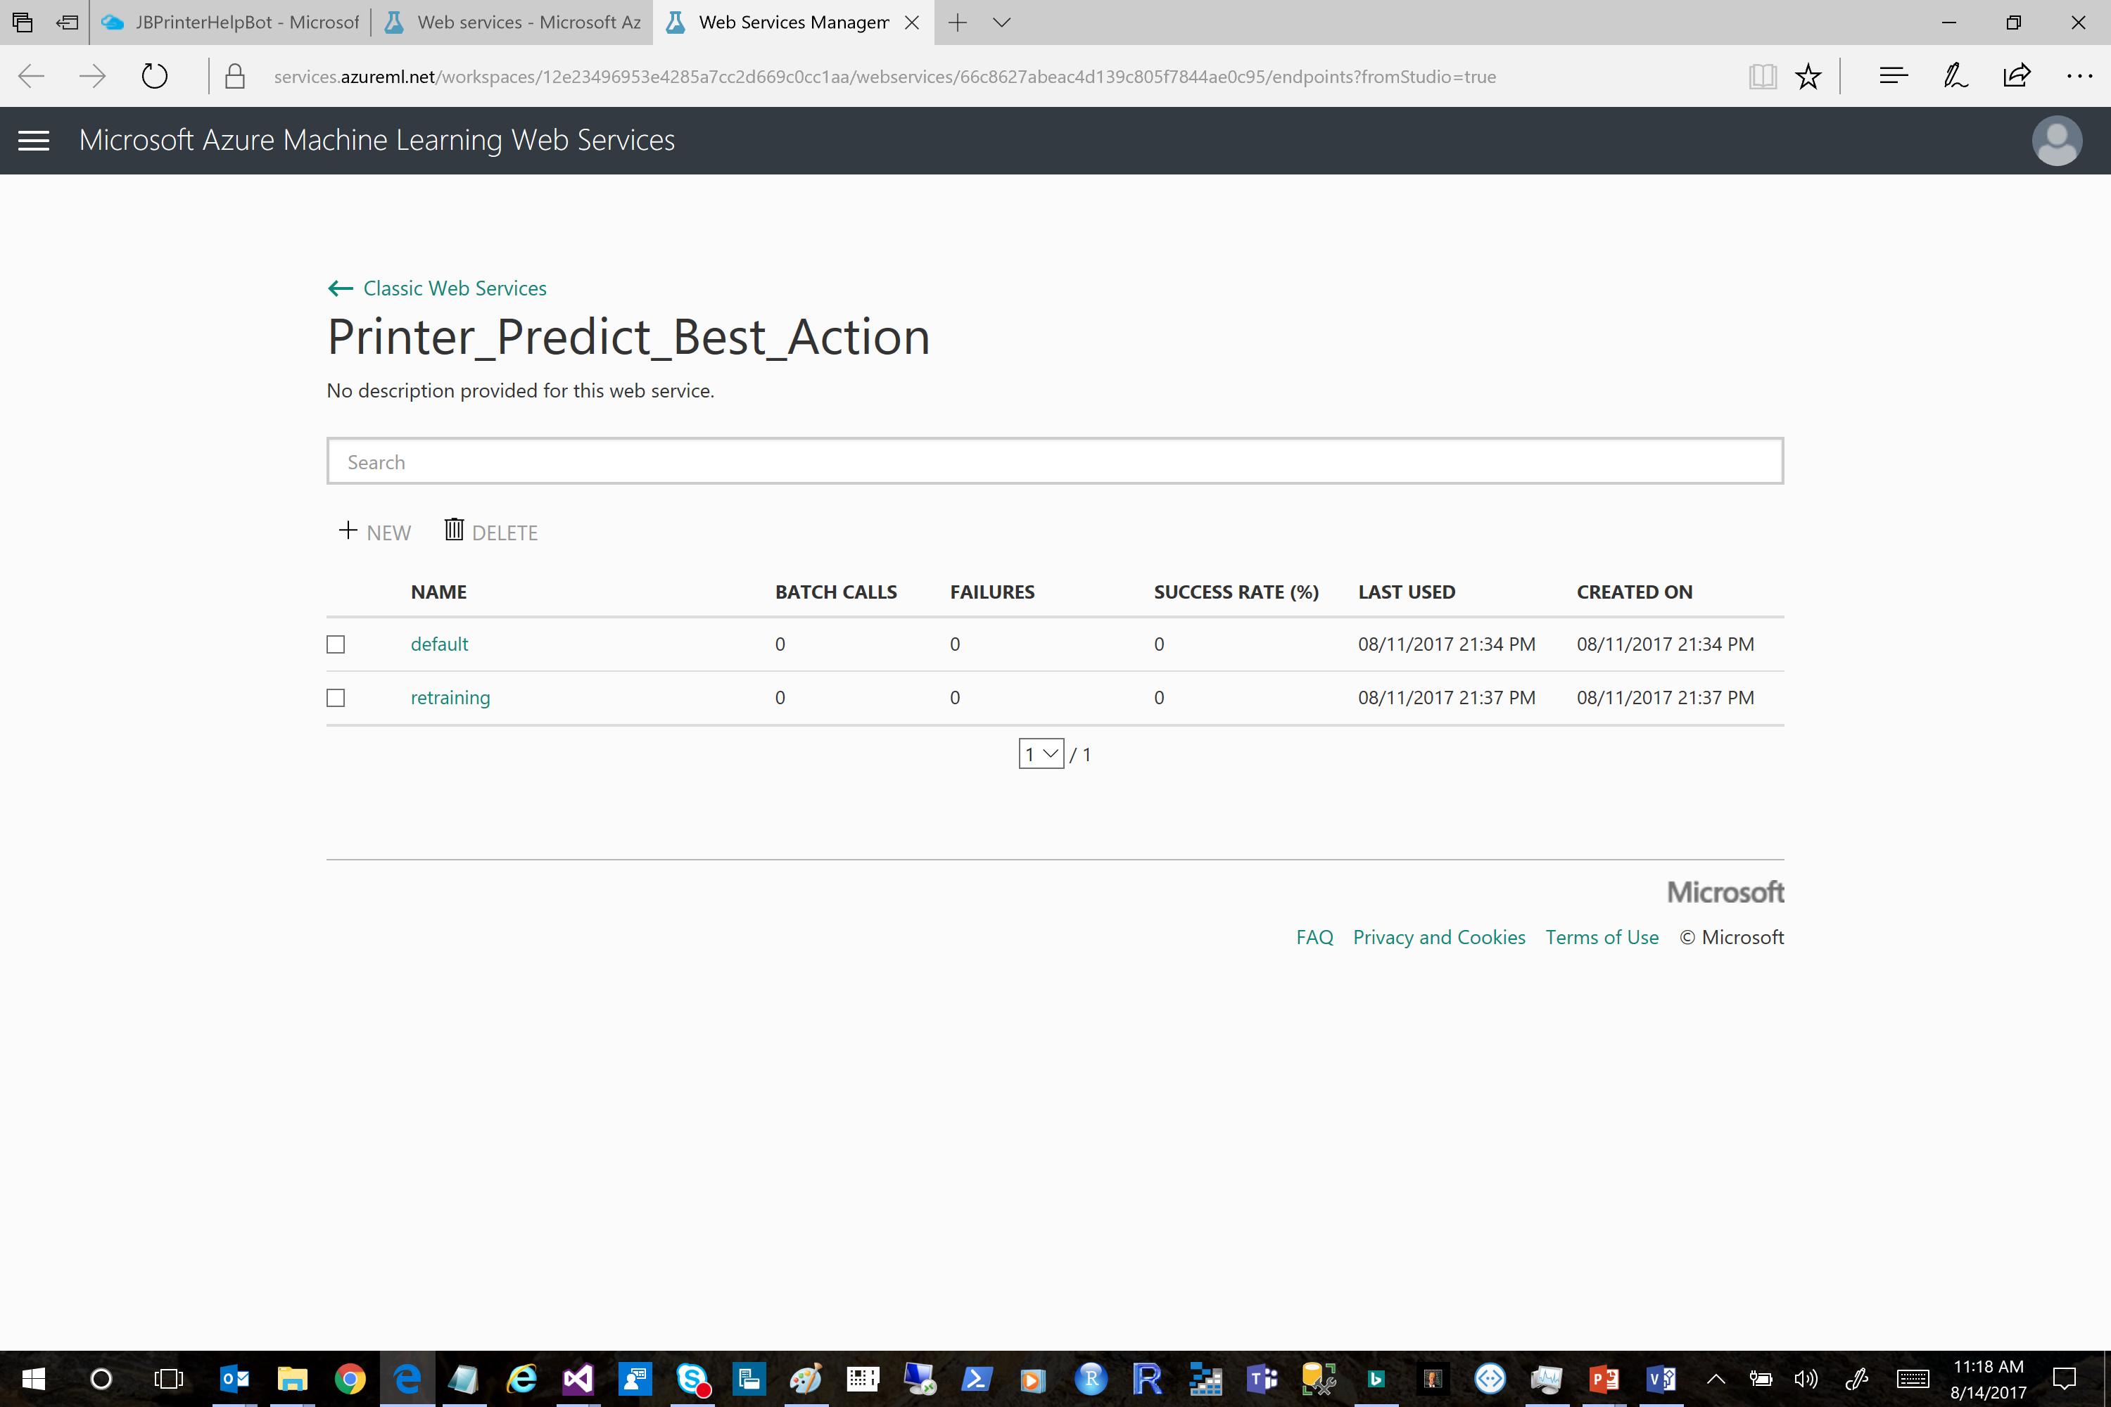

Slide 16
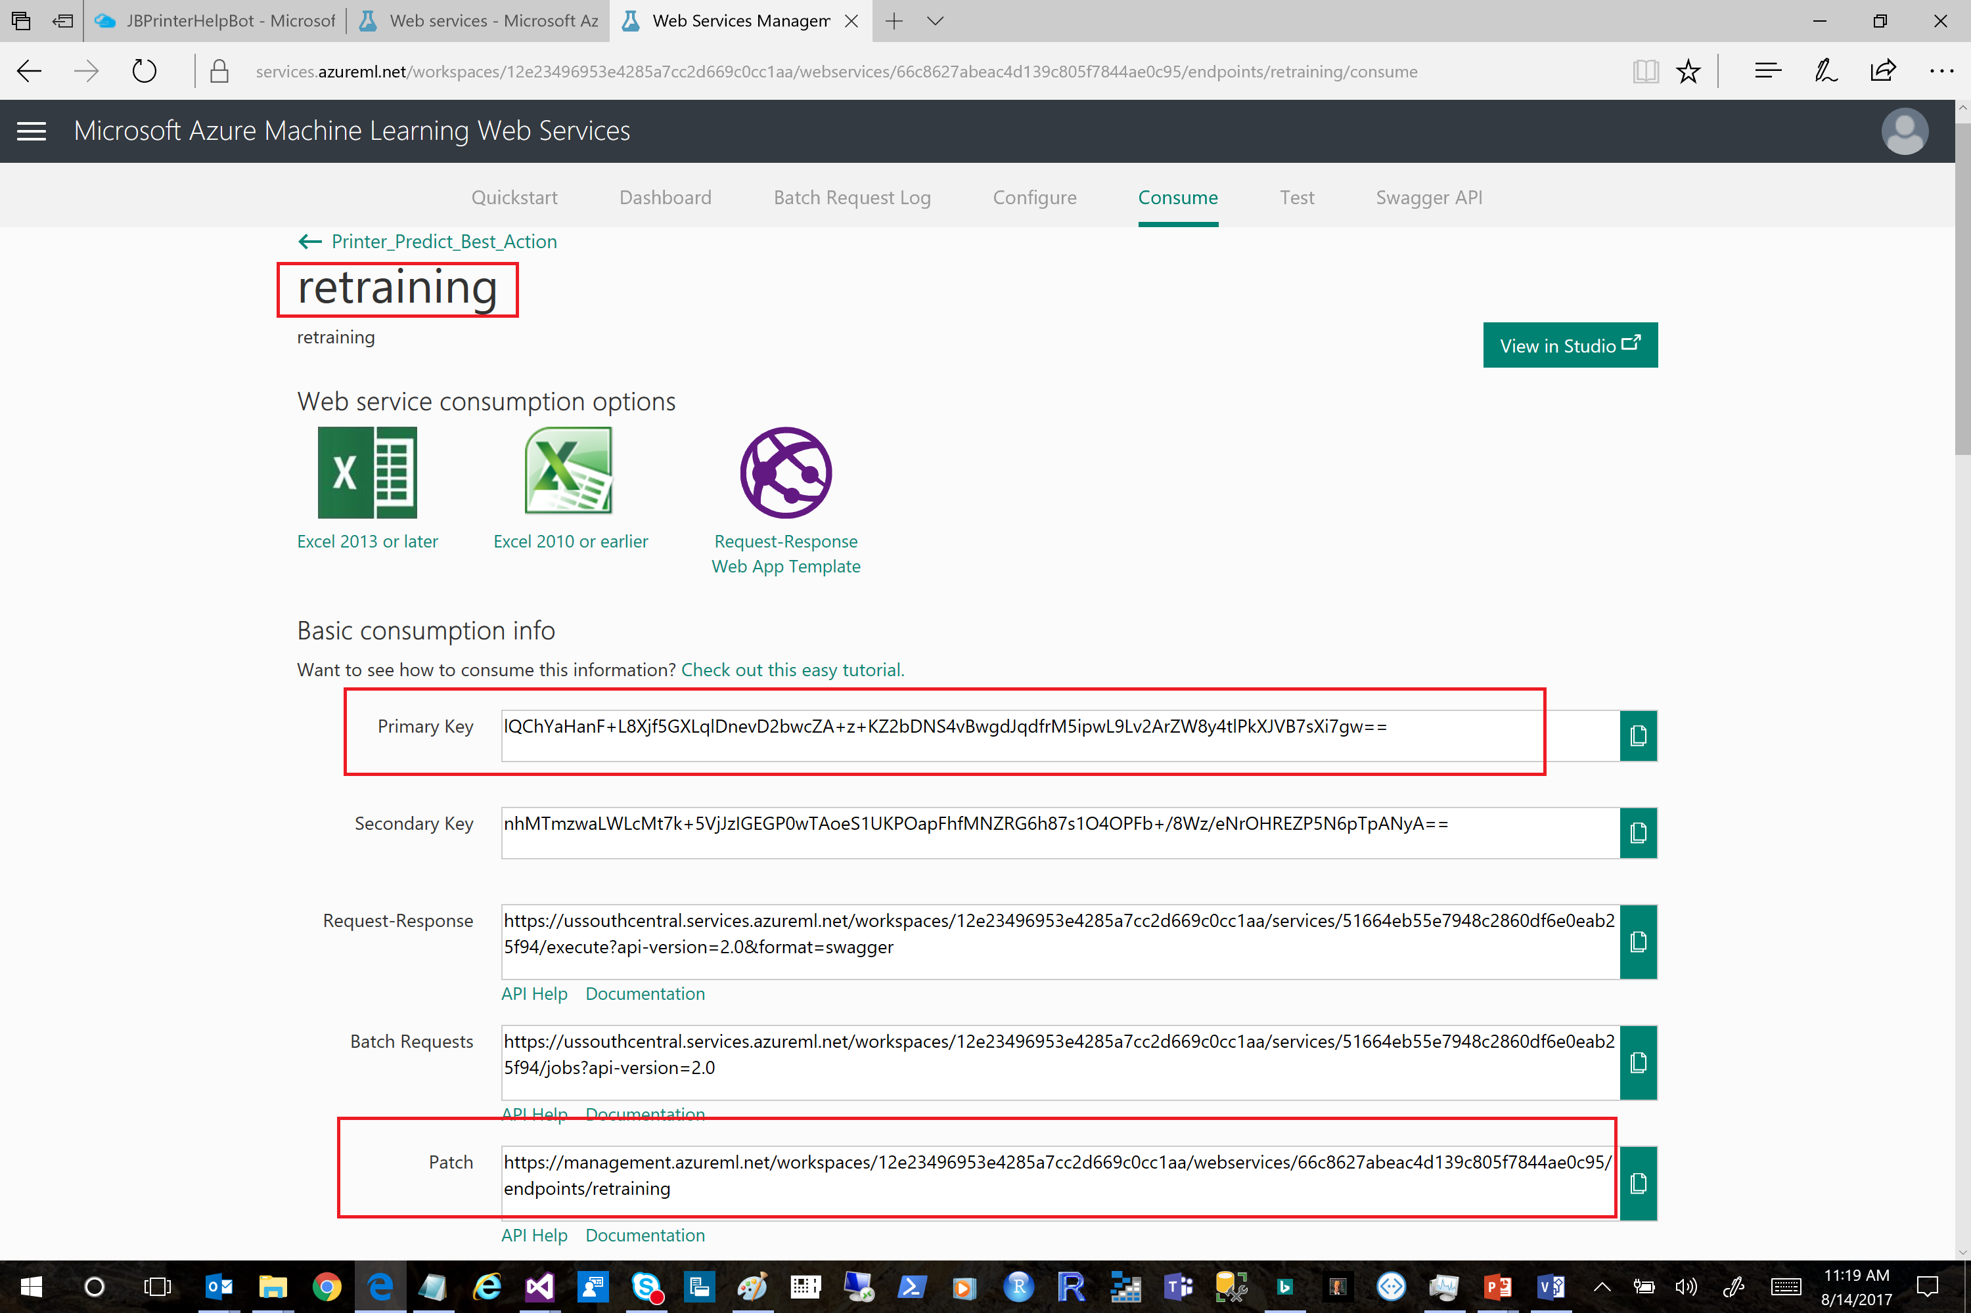

Slide 18
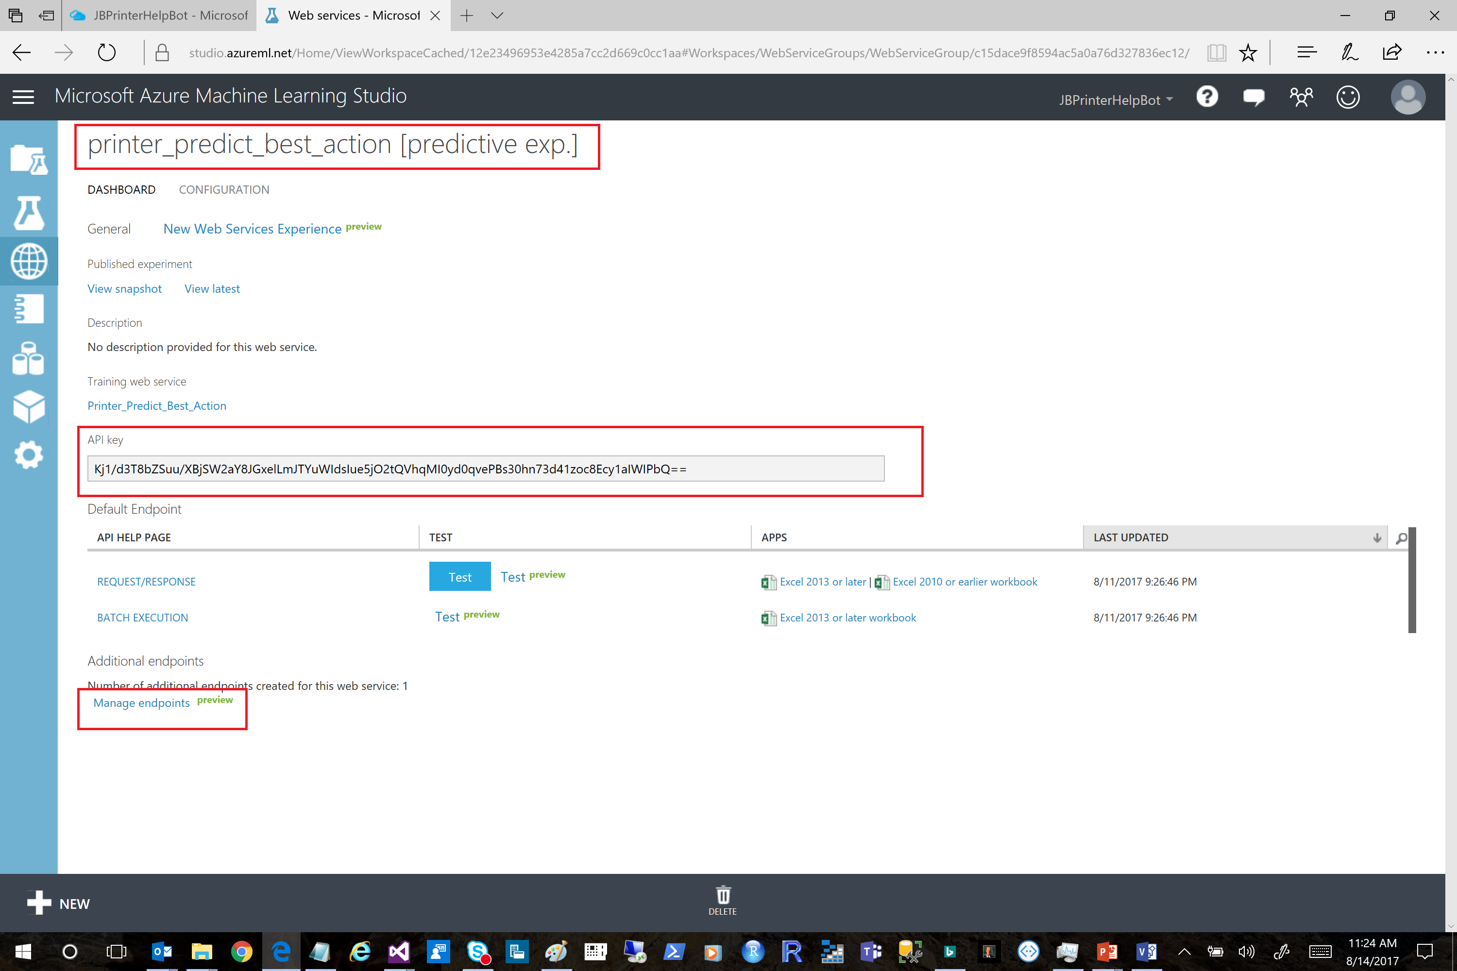

Slide 19
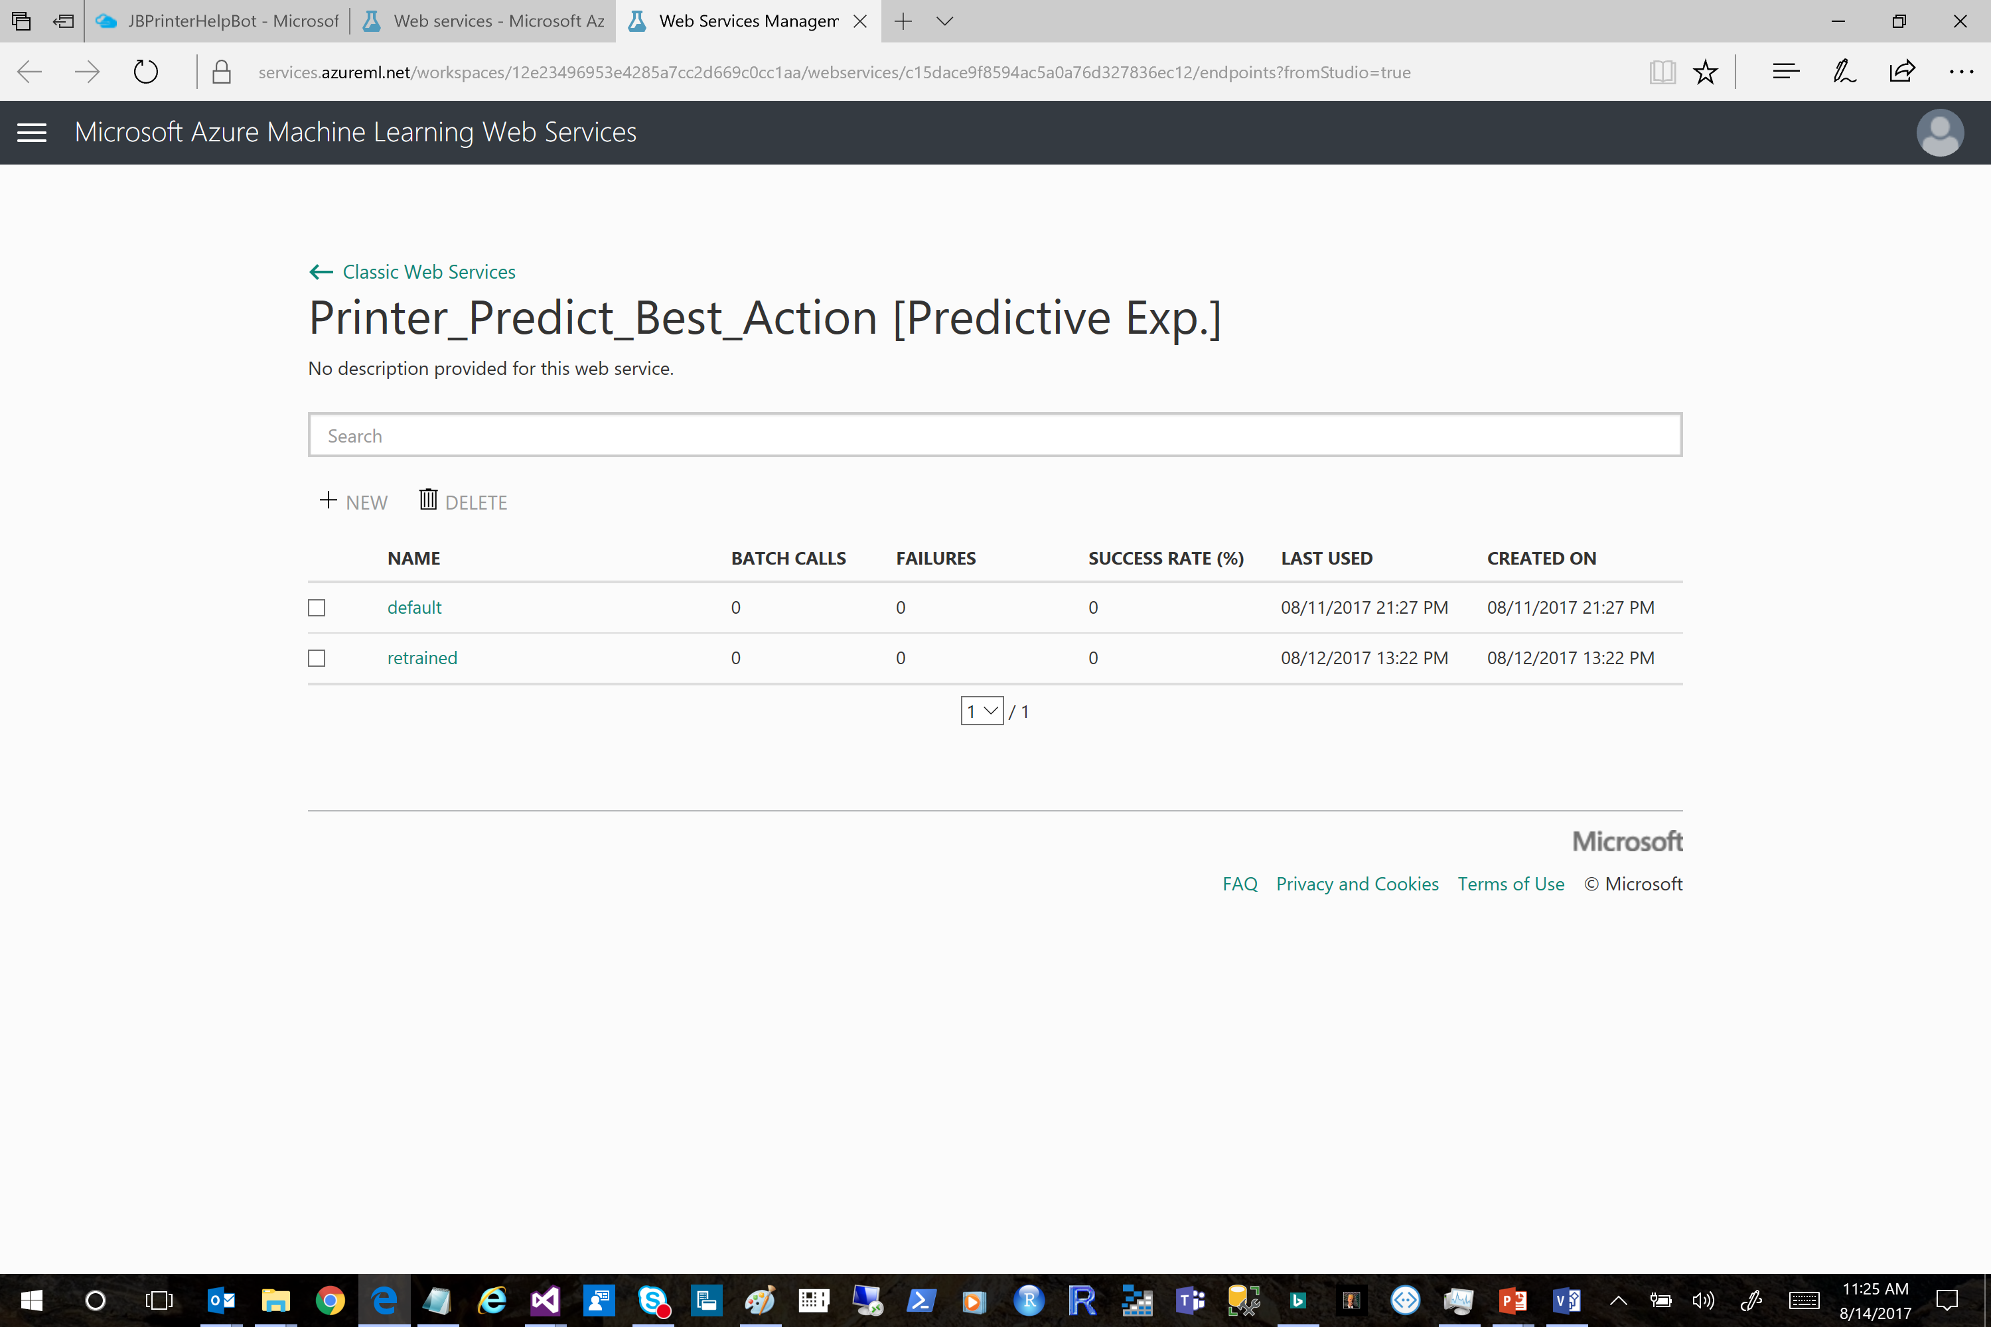

Slide 20
